Slide 1
CHAPTER : TWO
Intelligent Agent

Slide 2
Content
Intelligent Agent
Agent Schematic
Types of Agent
Rational Agents
Specifying Task Environments
Types of Environments

Slide 3
Intelligent Agent
I want to build a robot that will
  Clean my house
  Information filtering agents
  Cook when I don’t want to
  Wash my clothes
  Cut my hair
  Fix my car (or take it to be fixed)
  Take a note when I am in a meeting
  Handle my emails
  i.e. do the things that I don’t feel like doing…
AI is the science of building machines (agents) that act rationally with respect to a goal.

Slide 4
Types of Intelligent Agents
Software agents:
  Also called a softbot (software robot)
  It is an agent that interacts with a software environment by issuing commands and interpreting the environments feedback.
  E.g. mail handling agent, information filtering agent
Physical agents
  are robots that operates in the physical world and can perceive and manipulate objects in that world

Slide 5
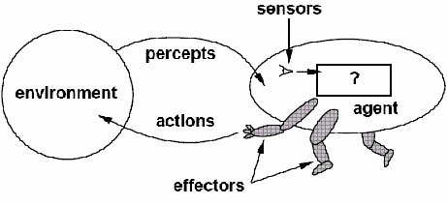
Agent
Agent is something that perceives/observes its environment through SENSORS and acts upon that environment through EFFECTORS.
The agent is assumed to exist in an environment in which it perceives and acts
An agent is rational/sensible since it does the right thing to achieve the specified goal.
Agent = architecture + program

Slide 6
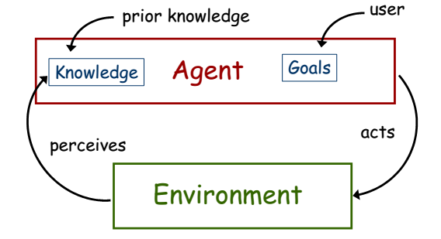
Require more flexible interaction with the environment, the ability to modify one’s goals, knowledge that be applied flexibly to different situations

Slide 7
Agent
 | Human beings | Agents
Sensors | Eyes, Ears, Nose | Cameras, Scanners, Mic, infrared range finders
Effectors | Hands, Legs, Mouth | Various Motors (artificial hand, artificial leg), Speakers, Radio

Slide 8
Examples of agents in different types of applications
Agent type
Percepts
Actions
Goals
Environment
Healthy patients, minimize costs
Medical diagnosis system
Symptoms, patient's answers
Questions, tests, treatments
Patient, hospital
Interactive English tutor
Typed words, questions, suggestions
Write exercises, suggestions, corrections
Maximize student's score on exams
Set of students, materials
Part-picking robot
Pixels of varying intensity
Pick up parts and sort into bins
Place parts in correct bins
Conveyor belts with parts
Print a categorization of scene
Correct categorization
Images from orbiting satellite
Satellite image analysis system
Pixels intensity, color
Refinery controller
Temperature, pressure readings
Open, close valves; adjust temperature
Maximize purity, yield, safety
Refinery

Slide 9
Rationality/Reasonableness vs. Omniscience/Awareness/knowledge
Rational agent acts so as to achieve one's goals, given one's beliefs (one that does the right thing).
  What does right thing mean? one that will cause the agent to be most successful and is expected to maximize goal achievement, given the available information
An Omniscient/all-knowing agent knows the actual outcome of its actions, and can act accordingly, but in reality omniscience is impossible.
Rational agents take action with expected success, where as omniscient agent take action with 100% sure of its success
Is human beings Omniscient or Rational agent?

Slide 10
Example
You are walking along the road to shewaber; You see an old friend across the street. There is no traffic.
So, being rational, you start to cross the street.
Mean while a big banner falls off from above and before you finish crossing the road, you are flattened.
Were you irrational to cross the street?
This points out that rationality is concerned with expected success, given what has been perceived.
  Crossing the street was rational, because most of the time, the crossing would be successful, and there was no way you could have foreseen the falling banner.
  The EXAMPLE shows that we can not blame an agent for failing to take into account something it could not perceive. Or for failing to take an action that it is incapable of taking.

Slide 11
Rational agent
In summary what is rational at any given point depends on four things.
  Perception/sensitivity: Everything that the agent has perceived so far concerning the current scenario in the environment
  Knowledge: What an agent already knows about the environment
  Action: The actions that the agent can perform back to the environment
  Performance measure: The performance measure that defines degrees of success of the agent.
Generally, rationality refers to “doing the right thing”.
  So that one key property of Intelligent Agents is being a rational agent, because rational agents means doing the right thing.
Therefore in designing an intelligent agent, one has to remember PEAS (Performance, Environment, Actuators, Sensors) framework.

Slide 12
Example 1: PEAS description for Automated Taxi Driver.
  Performance Measure
    How much it is safe, fast, legal, comfortable trip, maximize profits, etc.
  Environment
    The roads, pedestrians, customers, other traffic.
  Actuators
    The steering wheel, accelerator, brake, signal, horn, etc.
  Sensors
    The cameras, sonar, speedometer, GPS, odometer, engine sensors, keyboard, etc.

Slide 13
Example 2: PEAS description of Part-Sorting Robot
  Performance Measure
    Percentage of parts in correct bins
  Environment
    Conveyor belt with parts, bins
  Actuators
    Robotic arm
  Sensors
    Camera, joint angle sensors

Slide 14
Example 3: PEAS description of Spam Filter
  Performance Measure
    Minimizing false positives, false negatives
  Environment
    A user’s email account
  Actuators
    Mark as spam, delete, etc.
  Sensors
    Incoming messages, other information about user’s account

Slide 15
Performance measure
How do we decide whether an agent is successful or not?
  Establish a standard of what it means to be successful in an environment and use it to measure the performance.
  A rational agent should do whatever action is expected to maximize its performance measure, on the basis of the evidence provided by the percept sequence and whatever built-in knowledge the agent has.
What is the performance measure for “crossing the road”?
What about “Chess Playing”?

Slide 16
Assignment
Consider the need to design a “taxi driver agent” that serves in Debre markos city;
  Identify what to perceive, actions to take, the environment it interacts with?
  Identify sensors, effectors, goals, environment and performance measure that should be integrated for the agent to be successful in its operation?

Slide 17
Designing an agent/Agent Function
An agent function maps the percept histories to actions.
An agent program is the one that runs on the physical architecture to produce the agent function.
Agent = architecture + program
Architecture
  Runs the programs
  Makes the percept from the sensors available to the programs
  Feeds the program’s action choices to the effectors
Programs
  Accepts percept from an environment and generates actions
    Before designing an agent program, we need to know the possible percept and actions
  By enabling a learning mechanism, the agent could have a degree of autonomy/independence, such that it can reason and take decision

Slide 18
Types of Environments
1. Fully Observable vs. Partially Observable
Fully Observable Environment: The agent has access to complete information about the environment at any given time.
Example: A chess game environment is fully observable. The agent (player) can see the entire chessboard, all pieces, and their positions, so it has full knowledge of the environment at any moment.
Partially Observable Environment: The agent only has access to limited information about the environment, and it must make decisions with incomplete data.
Example: A self-driving car in a city is partially observable. The car has sensors (like cameras, radar, and lidar), but it cannot see everything in the environment (e.g., other cars may be hidden by obstacles, pedestrians might be partially out of view).
2. Deterministic vs. Stochastic
Deterministic Environment: The next state of the environment is completely determined by the current state and the agent’s action. If the agent does the same thing in the same state, it will always get the same result.
Example: Tic-Tac-Toe is a deterministic environment. The outcome of the game is fully determined by the moves each player makes, and if the same moves are made in the same order, the outcome will always be the same.
Stochastic Environment: The environment has an element of randomness, so even if the agent performs the same action in the same state, the result may vary.
Example: Roll of a dice in a board game is a stochastic environment. If an agent (player) rolls a die, the outcome is uncertain and probabilistic, so the agent cannot predict exactly what the result will be.

Slide 19
3. Episodic vs. Sequential
Episodic Environment: The agent's experience is divided into episodes where each action is independent of the previous one. The outcome of one episode does not affect the outcome of another.
Example: A spam email filter works in an episodic environment. Each email it processes is independent of the previous one. After processing one email, the agent's performance doesn't depend on the previous decisions.
Sequential Environment: The agent’s current decision affects future decisions. In sequential environments, actions taken in the past can influence the present and future states.
Example: A robot playing chess is in a sequential environment. Each move affects the subsequent moves, and the game continues with each move having consequences on future states.
4. Static vs. Dynamic
Static Environment: The environment does not change while the agent is making a decision. Once the agent is deciding on an action, the environment remains unchanged during that time.
Example: A mathematical problem-solving agent that solves problems like equations is operating in a static environment. The environment does not change while the agent is working on the problem.
Dynamic Environment: The environment can change while the agent is deciding or performing an action. The environment may update or evolve during the agent's interaction.
Example: A self-driving car operates in a dynamic environment because traffic conditions, weather, and other cars are constantly changing, which may require the car to adapt its actions in real-time.

Slide 20
5. Discrete vs. Continuous
Discrete Environment: The environment has a limited number of distinct states and actions. The agent can choose from a finite set of options, and time is divided into discrete steps.
Example: Board games like chess or checkers are discrete environments. The game board has a fixed number of squares and pieces, and the game proceeds in discrete turns.
Continuous Environment: The environment is not divided into discrete states or actions. It is continuous in nature, and time can flow without discrete steps.
Example: A robot moving in a warehouse operates in a continuous environment. The robot can move smoothly in any direction and can stop at any position, with no fixed grid or step-based movement.
6. Single-Agent vs. Multi-Agent
Single-Agent Environment: There is only one agent acting in the environment, and it doesn't interact with other agents.
Example: A vacuum cleaning robot is in a single-agent environment. It operates alone, cleaning a room without interacting with any other agents.
Multi-Agent Environment: Multiple agents interact with each other in the same environment, and the outcome can depend on the actions of other agents.
Example: A competitive video game like League of Legends involves multiple agents (players) acting in the same environment. The agents interact with each other, and the outcome of the game depends on how the agents (players) make decisions in response to one another.

Slide 21
Summary of Examples:
Type of Environment | Example
Fully Observable | Chess game
Partially Observable | Self-driving car
Deterministic | Tic-Tac-Toe
Stochastic | Rolling a dice in a board game
Episodic | Spam email filter
Sequential | Robot playing chess
Static | Mathematical problem-solving agent
Dynamic | Self-driving car
Discrete | Chess, Checkers
Continuous | Robot moving in a warehouse
Single-Agent | Vacuum cleaning robot
Multi-Agent | Competitive video game (e.g., League of Legends/A very popular multiplayer video game from Riot Games, Los Angeles, )
Conclusion:
The types of environments play a crucial role in determining how an agent should behave and how it learns or makes decisions. By understanding the characteristics of its environment (e.g., whether it's deterministic or stochastic, fully observable or partially observable), an agent can use the appropriate strategy to perform tasks more effectively.

Slide 22
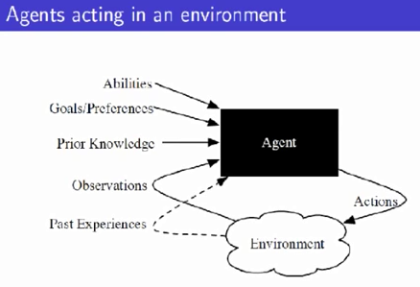

Slide 23
Hierarchy of Agent Types
Let’s have a closer look on the following five agent categories:-
Simple Reflex Agents
Model-Based Reflex Agents
Goal-Based Agents
Utility-Based Agents
Learning Agents

Slide 24
Simple Reflex Agents
Select action on the basis of current percept, ignoring all past percepts
It uses just condition-action rules
  The rules are like the form “if … then …”
  Efficient but have narrow range of applicability
  Because knowledge sometimes cannot be stated explicitly
  Work only
    If the environment is fully observable
  If car-in-front-is breaking then initiate-braking.
  Blinking when something approaches the eye.

Slide 25
Figure: Structure of a simple reflex agent
Simple Reflex Agent
sensors
What the world is like now
Environment
Condition - action rules
What action I should do now
effectors
function SIMPLE-REFLEX-AGENT(percept) returns action
static: rules, a set of condition-action rules
state ← INTERPRET-INPUT (percept)
rule ← RULE-MATCH (state,rules)
action ← RULE-ACTION [rule]
return action

Slide 26
Examples of Simple Reflex Agent
Imagine a robot vacuum cleaner designed to clean a room. The robot uses simple reflex logic to decide when and how to act.
Sensors: The robot has sensors that detect dirt and obstacles on the floor.
Rules: The robot is programmed with a set of rules like:
  If dirt is detected in front, then move forward.
  If obstacle is detected, then turn left.
  If the battery is low, then go to the charging station.
Scenario:
Situation: The robot detects dirt in front of it.
  Condition: Dirt is detected.
  Action: Move forward.
Situation: The robot detects an obstacle in front of it.
  Condition: Obstacle detected.
  Action: Turn left.
Situation: The robot’s battery is running low.
  Condition: Low battery.
  Action: Return to the charging station.

Slide 27
Model-Based Reflex Agents
Maintains internal state that keeps track of aspects of the environment that cannot be currently observed
For the world that is partially observable
  The agent has to keep track of an internal state
    That depends on the percept history
    Reflecting some of the unobserved aspects
    Example, driving a car and changing lane
Requiring two types of knowledge
  How the world evolves independently of the agent
  How the agent’s actions affect the world
  The agent is with memory

Slide 28
Figure: Structure of Model-Based reflex agent
State
sensors
How the world evolves
What the world is like now
What my actions do
Environment
Condition - action rules
What action I should do now
effectors
function REFLEX-AGENT-WITH-STATE (percept) returns action
static: state, a description of the current world state
rules, a set of condition-action rules
state ← UPDATE-STATE (state, percept)
rule ← RULE-MATCH (state, rules)
action ← RULE-ACTION [rule]
state ← UPDATE-STATE (state, action)
return action

Slide 29
Example:
Consider a robot vacuum cleaner again, but this time as a Model-Based Reflex Agent.
Components:
Sensors: The robot has sensors to detect dirt and obstacles, just like before.
Internal Model: The robot maintains a map of the room and tracks the locations of dirt and obstacles over time. It also keeps track of its battery level and position in the room.
Rules: The robot is programmed with more complex rules that take into account both the current state and its internal model.
Rules Example:
If dirt is detected in front of me, and I haven’t cleaned this area before, then clean the area.
If there is an obstacle in front of me, then check my map. If I haven’t encountered this obstacle before, I’ll go around it. If I have already avoided it once, I’ll try a different direction.
If my battery is low, return to the charging station (taking into account that I need to avoid obstacles and dirt on the way).

Slide 30
Scenario:
Initial Situation:
  The robot's internal model shows that it has cleaned most of the room, but there is a patch of dirt detected in the center.
  Condition: Dirt detected in front of the robot (not cleaned yet).
  Action: The robot cleans the area. It updates its internal model to reflect that this area is now clean.
Obstacle Encounter:
  The robot detects an obstacle ahead (e.g., a chair).
  Condition: Obstacle detected.
  Action: The robot looks at its internal map to check if it has encountered this obstacle before. If it has, the robot knows the path around it and moves around the chair. If it hasn't, it explores the obstacle by choosing a new path.
Low Battery:
  The robot detects that its battery is low.
  Condition: Low battery.
  Action: The robot consults its internal model and calculates the shortest path to the charging station, avoiding obstacles and cleaned areas, and returns to recharge.

Slide 31
How It Works:
The Simple Reflex Agent would just react to dirt and obstacles, using basic rules to move around.
The Model-Based Reflex Agent not only reacts to the immediate situation but also considers what it knows about the environment (e.g., its cleaned areas, obstacles it has encountered before, and the battery level). This allows it to make better decisions based on past experiences and not just the current state.
Key Difference:
Simple Reflex Agent: Reacts only to the current percept (like detecting dirt).
Model-Based Reflex Agent: Uses an internal model to store past information (e.g., cleaned areas, obstacles) and reacts accordingly, improving decision-making over time.

Slide 32
Example Table Agent With Internal State
IF
THEN
Saw an object ahead, and turned right, and it’s now clear ahead | Go straight
Saw an object Ahead, turned right, and object ahead again | Halt/stop
See no objects ahead | Go straight
See an object ahead | Turn randomly

Slide 33
Goal-Based Agents
The agent uses goal information to select between possible actions in the current state
Current state of the environment is always not enough
The goal is another issue to achieve
  Judgment of rationality / correctness
Actions chosen ➔ goals, based on
  The current state
  The current percept

Slide 34
Conclusion
  Goal-based agents are less efficient
  But more flexible
    Agent ⬅ Different goals ⬅ different tasks
  Search and planning
    Two other sub-fields in AI
    To find out the action sequences to achieve its goal

Slide 35
Figure: Structure of a Goal-based agent
State
sensors
How the world evolves
What the world is like now
What my actions do
What it will be like if I do action A
Environment
Goals
What action I should do now
effectors
function GOAL_BASED_AGENT (percept) returns action
state ← UPDATE-STATE (state, percept)
action ← SELECT-ACTION [state, goal]
state ← UPDATE-STATE (state, action)
return action

Slide 36
A Goal-Based Agent is more advanced than a Model-Based Reflex Agent because it not only reacts to the environment but also plans and takes actions to achieve specific goals. These agents are typically able to consider future states and use reasoning or search algorithms to figure out how to reach their goals from the current state. They are capable of handling more complex tasks that require deliberation, goal setting, and decision making.
Example:
Consider a robot vacuum cleaner again, but this time as a Goal-Based Agent.
Components:
Sensors: The robot detects dirt, obstacles, and its own position.
Internal Model: The robot has a map of the room and tracks areas that have been cleaned.
Goal: The robot has a goal to clean the entire room, but it must avoid obstacles and minimize energy usage.
Scenario:
Let's say the robot has the following goal: "Clean the entire room and return to the charging station when done."
The robot will consider the current state of the room, its battery level, and its internal model of the world. Based on these, it will plan a series of actions to achieve the goal.

Slide 37
Key Aspects of Goal-Based Agents:
Goal-Oriented: The robot has a specific end goal (clean the room and then recharge).
Planning: The robot considers the best sequence of actions to achieve the goal, rather than reacting impulsively.
Decision Making: The robot uses information about the environment, its current state, and its goal to make decisions (like when to avoid obstacles or go to recharge).
Comparison to Previous Agents:
Simple Reflex Agent: Would just react to the environment (clean when it detects dirt).
Model-Based Reflex Agent: Would keep track of its cleaning history and react to the environment, but wouldn't plan ahead.
Goal-Based Agent: Plans ahead and makes decisions with the goal of achieving a specific objective, considering future states and possible actions. It doesn't just react to current conditions but works toward fulfilling a goal in a deliberate way.
Example in Action:
Goal: Clean the entire room.
State: Room is partially cleaned.
Action: The robot plans a route to clean the remaining areas.
Goal Change: If battery is low, the goal becomes to return to the charging station.
State Update: Once the room is cleaned, the robot plans to return to the charging station.
By using this approach, the robot makes smarter, more efficient decisions and can adapt to changes in its environment, like running out of battery or encountering new obstacles.

Slide 38
Utility-Based Agents
The agent uses a utility function to evaluate the desirability of states that could result from each possible action
Goals alone are not enough
  To generate high-quality behavior
  Example, meals in Canteen, good or not ?
Many action sequences ➔ the goals
  Some are better and some worse
  If goal means success,
  Then utility means the degree of success (how successful it is)

Slide 39
Figure: Structure of a utility-based agent
State
sensors
How the world evolves
What the world is like now
What my actions do
What it will be like if I do action A
Environment
Utility
How happy I will be in such as a state
What action I should do now
effectors
function UTILITY_BASED_AGENT (percept) returns action
state ← UPDATE-STATE (state, percept)
action ← SELECT-OPTIMAL_ACTION [state, goal]
state ← UPDATE-STATE (state, action)
return action

Slide 40
A Utility-Based Agent is an agent that doesn't just try to achieve a goal; it also tries to maximize a utility function, which is a numerical representation of how "good" or "desirable" a particular state or outcome is. Unlike a Goal-Based Agent, which only cares about reaching a goal, a Utility-Based Agent makes decisions by weighing different possible outcomes and choosing the one that maximizes its utility.
Example:
Let's use a robot vacuum cleaner again, but now as a Utility-Based Agent.
Components:
Sensors: The robot detects dirt, obstacles, and its position.
Internal Model: The robot has a map of the room and tracks areas that have been cleaned.
Utility Function: The robot has a utility function that assigns a value to each possible state based on how clean the room is, how much energy it has left, and its proximity to the charging station.
Scenario:
The robot’s goal is still to clean the room, but its actions now depend on maximizing a utility function that considers multiple factors:
Cleaning the room: The robot earns utility for each area it cleans.
Energy levels: The robot loses utility when its battery is low.
Efficiency: The robot wants to clean as much as possible while minimizing energy use (so it doesn’t waste battery moving unnecessarily).
Time: The robot also values saving time but not at the cost of energy or thorough cleaning.

Slide 41
Example in Action:
Goal: Clean the room while managing battery life and time efficiently.
State: The robot knows that it has cleaned part of the room and has a low battery.
Action: The robot decides to clean an area near the charging station, which maximizes its utility by conserving battery while still making progress on its goal.
Re-evaluation: The robot continues to monitor its utility function and adapts as needed (e.g., it may return to the charging station if battery levels get too low).
By considering multiple factors, the Utility-Based Agent makes more nuanced and efficient decisions, maximizing its overall effectiveness in achieving its goals.

Slide 42
Learning Agents
A Learning Agent is an agent that can improve its performance over time by learning from its experiences. Unlike traditional agents that follow a fixed set of rules or plans, a Learning Agent can adapt and modify its behavior based on feedback it receives from the environment. This allows it to perform better in situations where the environment is dynamic or uncertain.
Key Features of Learning Agents:
Improvement Over Time: The robot improves its cleaning strategy based on past experiences.
Feedback-Driven: The robot learns from feedback (positive or negative) about its actions.
Adaptability: The robot adapts to changes in the environment (like moving furniture or new obstacles).
Flexibility: The robot can learn to handle different rooms, different types of dirt, and different obstacles.
A Learning Agent like this robot vacuum cleaner doesn't just follow fixed rules or goals. It improves over time by learning from its mistakes and successes, making it more effective and adaptable in real-world environments. This ability to learn from experience is a key distinction of learning agents, allowing them to perform better in uncertain or dynamic situations.

Slide 43
Four conceptual components
  Learning Element
    Which is responsible for making improvement
  Performance Element
    Which is responsible for selecting external actions
  Critic
    The learning element uses feedback from the critic on how the agent is doing and determines how the performance element should be modified to do better in the future.
    Tells the Learning element how well the agent is doing with respect to fixed performance standard.
      Feedback from user or examples, good or not?
Problem Generator
Responsible for suggesting actions that will lead to new and informative experiences

Slide 44
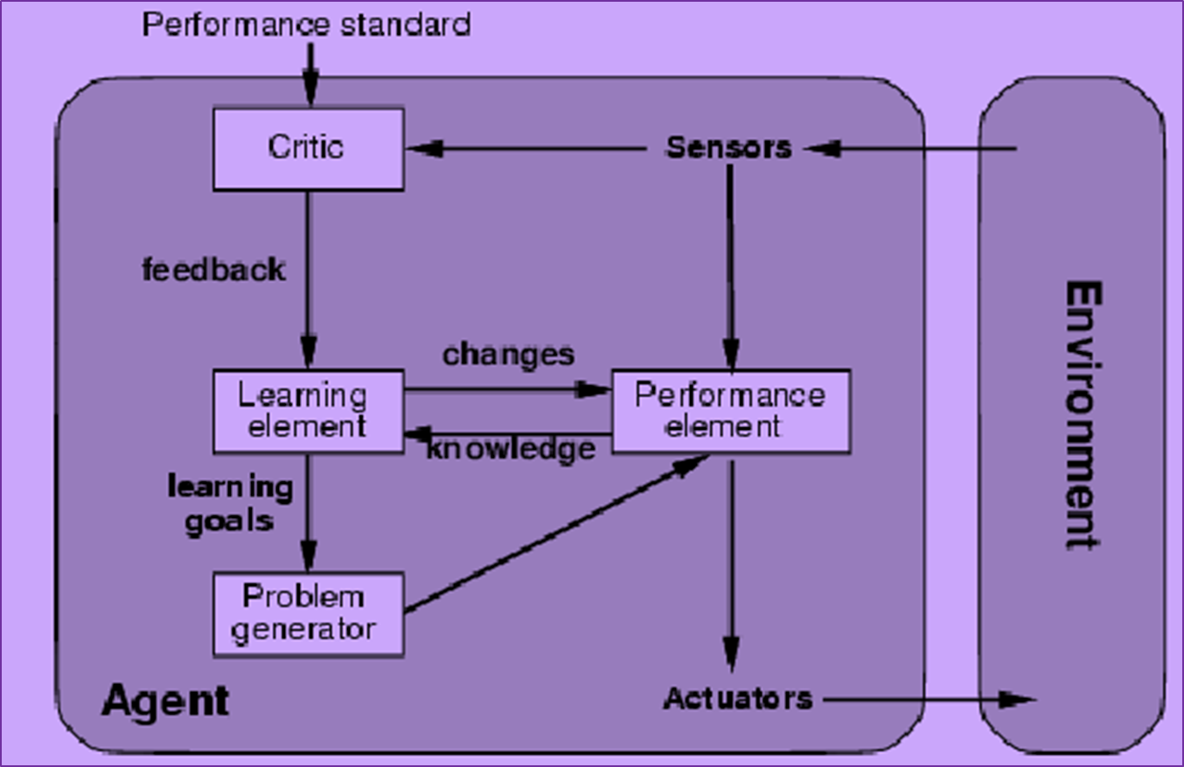
Figure: Structure of a Learning agent

Slide 45
Summery hierarchy in types of agents
Comparison to Other Agents:
Simple Reflex Agent: Reacts to dirt and obstacles with predefined rules, not capable of learning.
Model-Based Reflex Agent: Keeps track of the environment but doesn’t adapt its behavior based on experience.
Goal-Based Agent: Works toward specific goals but doesn't learn from its experience to improve performance.
Utility-Based Agent: Maximizes utility, but again, does not learn from experience.
Learning Agent: Continuously improves by learning from past experiences and feedback, adapting its behavior over time.

